Slide 1
instrumentation Mass spectrometry Dr: leaqaa Abd Al-Redha

Slide 2
* (MS) is super potent technique - To give M.Wt -molecular formula - Elements represent - structural information (fragmentation pattern)

Slide 3
The mass spectrometer performs 3 essential functions: 1st it subjects molecules to bombardment by stream of high energy electrons, converting some of molecules to ions which accelerated in an electric field. 2nd ,the accelerated ions are separated according to their m/z ratio in a magnetic or electric field. Finally,the ions that have a particular m/z ratio are detected ,amplified and recorder then give mass spectrum

Slide 4
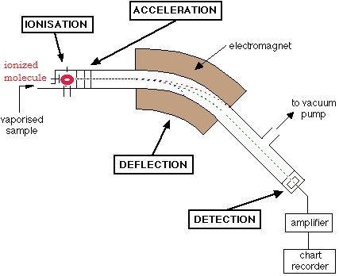
Basic principle: a charged particles moving in a magnetic field *degree of deflection depends on mass/charge deflected less - heavier molecule more charged = deflected more -

Slide 5
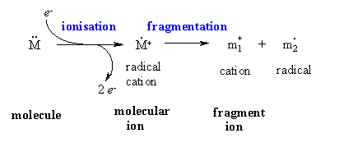
Probably the most useful information you should be able to obtain from a MS spectrum is the molecular weight of the sample. • This will often be the heaviest ion observed from the sample provided this ion is stable enough to be observed

Slide 6
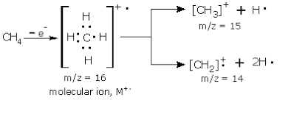
Electron Ionization (EIMS): the basic idea ,wn can used one electront to ionized the molecule M + eˉ → M⁺ +2eˉ - if you take CH4

Slide 7
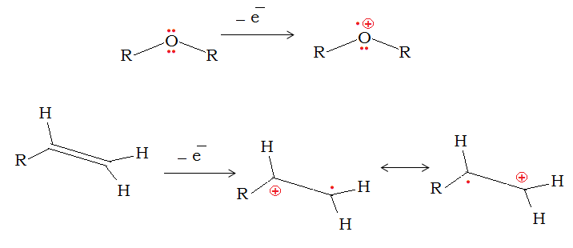

Slide 8
The order of energy required to remove electron is as follows : δ electron ˃ non-conjugated ¶ > conjugated ¶ > non bonding or lone pair of electrons

Slide 9
* Most molecules show a peak for the molecular ion, the stability of which is usually in the order : Aromatic > Conjugated acyclic polyenes> Alicyclics > n-hydrocarbons > ketones > ethers > Branched chain hydrocarbons > Alcohols

Slide 11
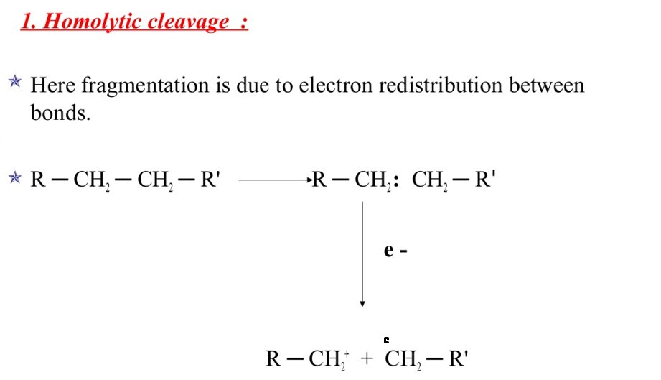

Slide 13
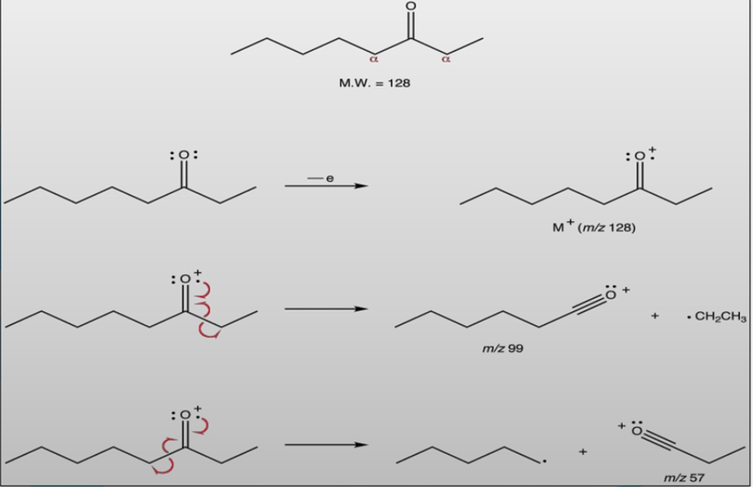

Slide 14
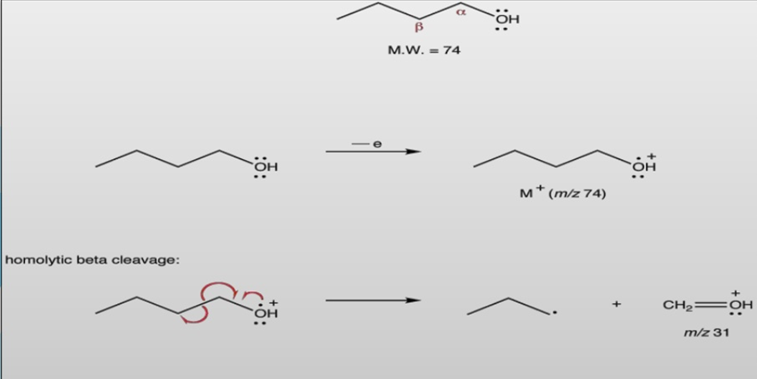

Slide 15
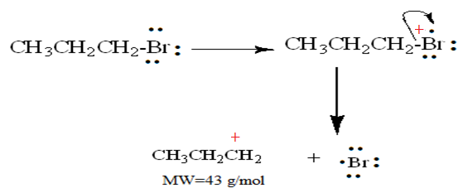
2- Heterolytic cleavage: *Alkyl halide : * Alcohol: = Ethers*

Slide 16
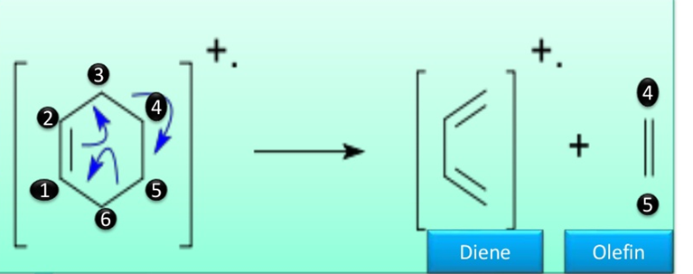

Slide 17
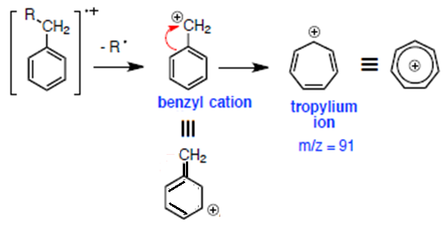
* Rearrangement reactions accompanied by transfer of atoms: 1- Scrambling fragmentation giving rise to stable carbocation: ex- M⁺ from Alkyl benzen undergoes at benzylic bond and final product is 7 membered cyclic ion known as Tropylium ion

Slide 18
3- McLafferty rearrangement: (intramolecular atomic rearrangment) * must have γ-H = an unsaturation point

Slide 19
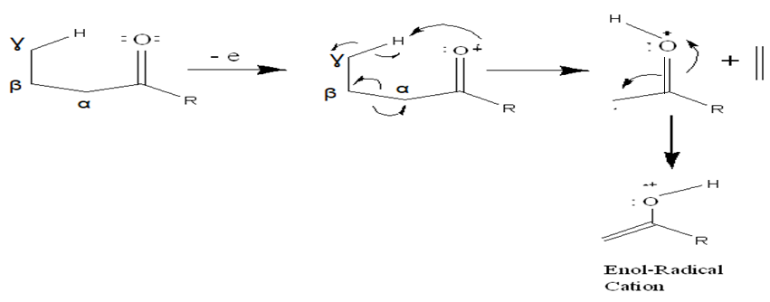

Slide 22
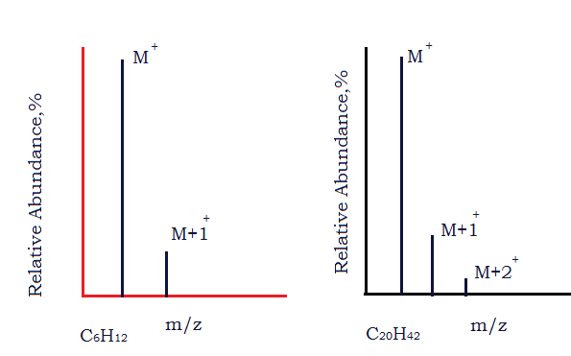
Isotopes - most elements common to organic cpds r mixtures of isotopes. - the existence of atomic isotopes in nature accounts for the appearance of M+1 and M+2 peaks in a mass spectrum. - organic cpds containing only C,H,O and N usually have relatively small M+1 and M+2 Peaks.

Slide 23
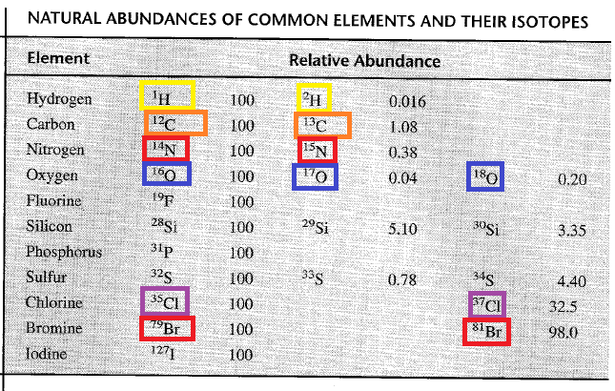

Slide 24
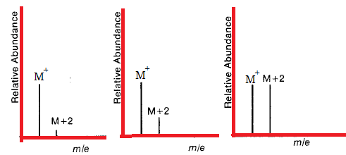
ISOTOPES: MS is particularly valuable for cpds w contain Cl and Br: - if one S atom is present,M+2 is ≈ 4% of M⁺ - if one Cl atom is present, M+2 is ≈ 33% of M⁺ - = = Br atom is present ,M+2 is ≈ to M⁺

Slide 25
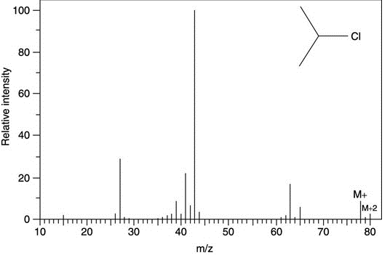
Mass spectrum with chlorine

Slide 26
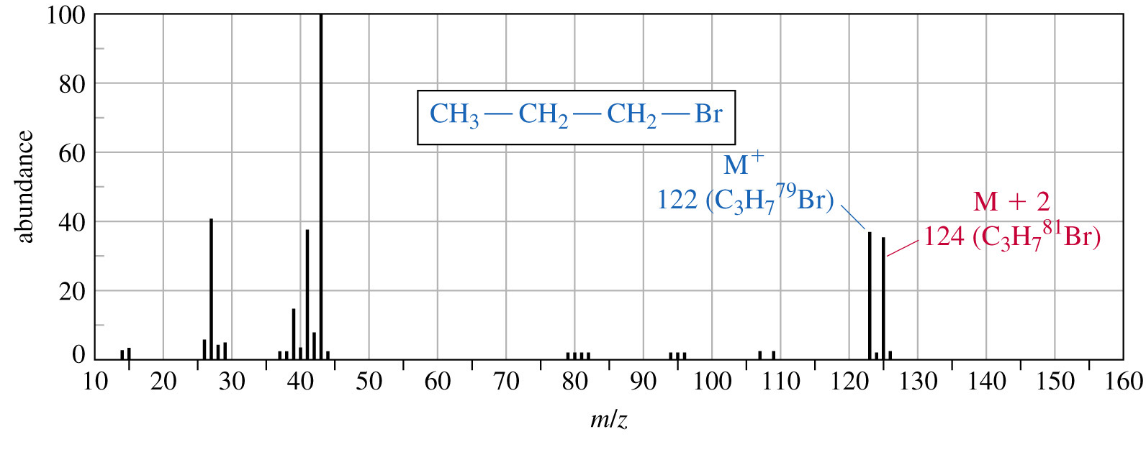

Slide 27
Carbone rule: * for cpds containing only C,H and O the following formula can be used to determine the # C in the molecule:

Slide 28
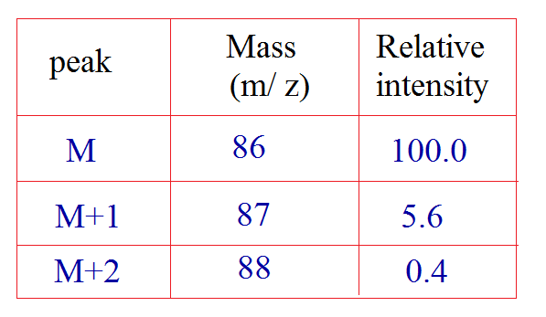
Can determine the molecular formula of unknown organic cpd whose mass spectral data is given in the table below:

Slide 29
Nitrogen rule: - if a cpd with even # N(no N or even)= give even (M⁺) , - if cpd with odd # N= (M⁺) will be odd ex: C2H5NH2 M⁺= 45 H2NCH2CH2NH2 M⁺=60 (CH3)3CH M⁺=58

